Slide 1
Twire
Anywhere Anytime

Slide 2

Introduction
Twire is a platform which connects the Technical network at one platform to provide quick services and get people out of problems at their desired place, Just a click away.

Slide 3



Problem Statement
Wastage of Time
Untrustworthy
technicians
Unavailability of Technicians

Slide 4



Solution
Desired
Location
Reliable Technicians
Time
Saver

Slide 5




Unique Selling Proposition
Location Tracking
System
Professional
Technicians
Quick
Assistance
Auto
Forwarding

Slide 6


Revenue Streams
Advertisements
Commission

Slide 7


Target Market
Single Mothers
Job Oriented people

Slide 8









Business Model
KEY ACTIVITIES
VALUE PROPOSITION
CUSTOMER RELATIONSHIPS
KEY PARTNERS
CUSTOMER SEGMENTS
CHANNELS
KEY RESOURCES
COST STRUCTURE
REVENUE STREAMS
Product Development
1:Hukum Janab
2:Car with Helpline
1:Route Tracking
2:All technical Services in one app
3:Allows to find most near technicians
1:Location tracking
2:Quick Assistance
1:Single Mothers
2:Technicians
3: Job Oriented people
Number of technicians
And User
1:Campaign
2:Social Media Apps
1:workshop for Technicians 2:Product development 3: Marketing Expense
1:Subscription of Technicians 2:Commision per order 3:Advertisement

Slide 9
Marketing Plan
What is the goal of your marketing strategy?
Who is your target market?
What strategies will you be using to achieve your marketing goals?
How much money will your marketing strategy cost?
To Provide service at
Your Desired place
like Home, office.
Primary
females
Single mothers
Others
Job oriented people
Secondary
People having no prior knowledge of dealing with technical problems.
Paid Promotions Optimized to Target Busy Persons and Single mothers
Word of mouth through university incubation.
Instagram ad to reach young mothers.
B2B Collaborations through LinkedIn.
Brochures and posters.
Live sessions and Training Programs for technicians
Training Programs
Per session cost 5000; at least 3 sessions/month
100000 / year
Paid social media marketing
Estimated 40,000
Cost varies according to packages
Printing for poster, certificate ,flyers: 80000

Slide 10
Financial Plan
Service Charges Model
Advertisement model
Total Revenue
Training Programs And Marketing
General & Administrative Expenses
Total Expense
Profit / Loss
Balance
2022
2023
2024
0 100,000 100,000
0 25000 100,000
0 100,000 200,000
100,000 100,000 100,000
200,000 200,000 200,000
300,000 300,000 300,000
-300,000 300,000 300,000
-300,000 325,000 400,000

Slide 11
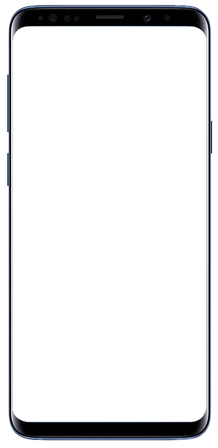
Prototype

Slide 12









Working FLow
Registration
Login
Select Technician
Mobile App
Payment
Location

Slide 13
Scalability & Viability
Phase-1
Phase-2
Phase-3
We Start our Service from Jamshoro & its surrounding
After launching we move towards Karachi & try to capture the market of karachi
After the stable condition we move towards entire Sindh & then whole Pakistan.

Slide 14
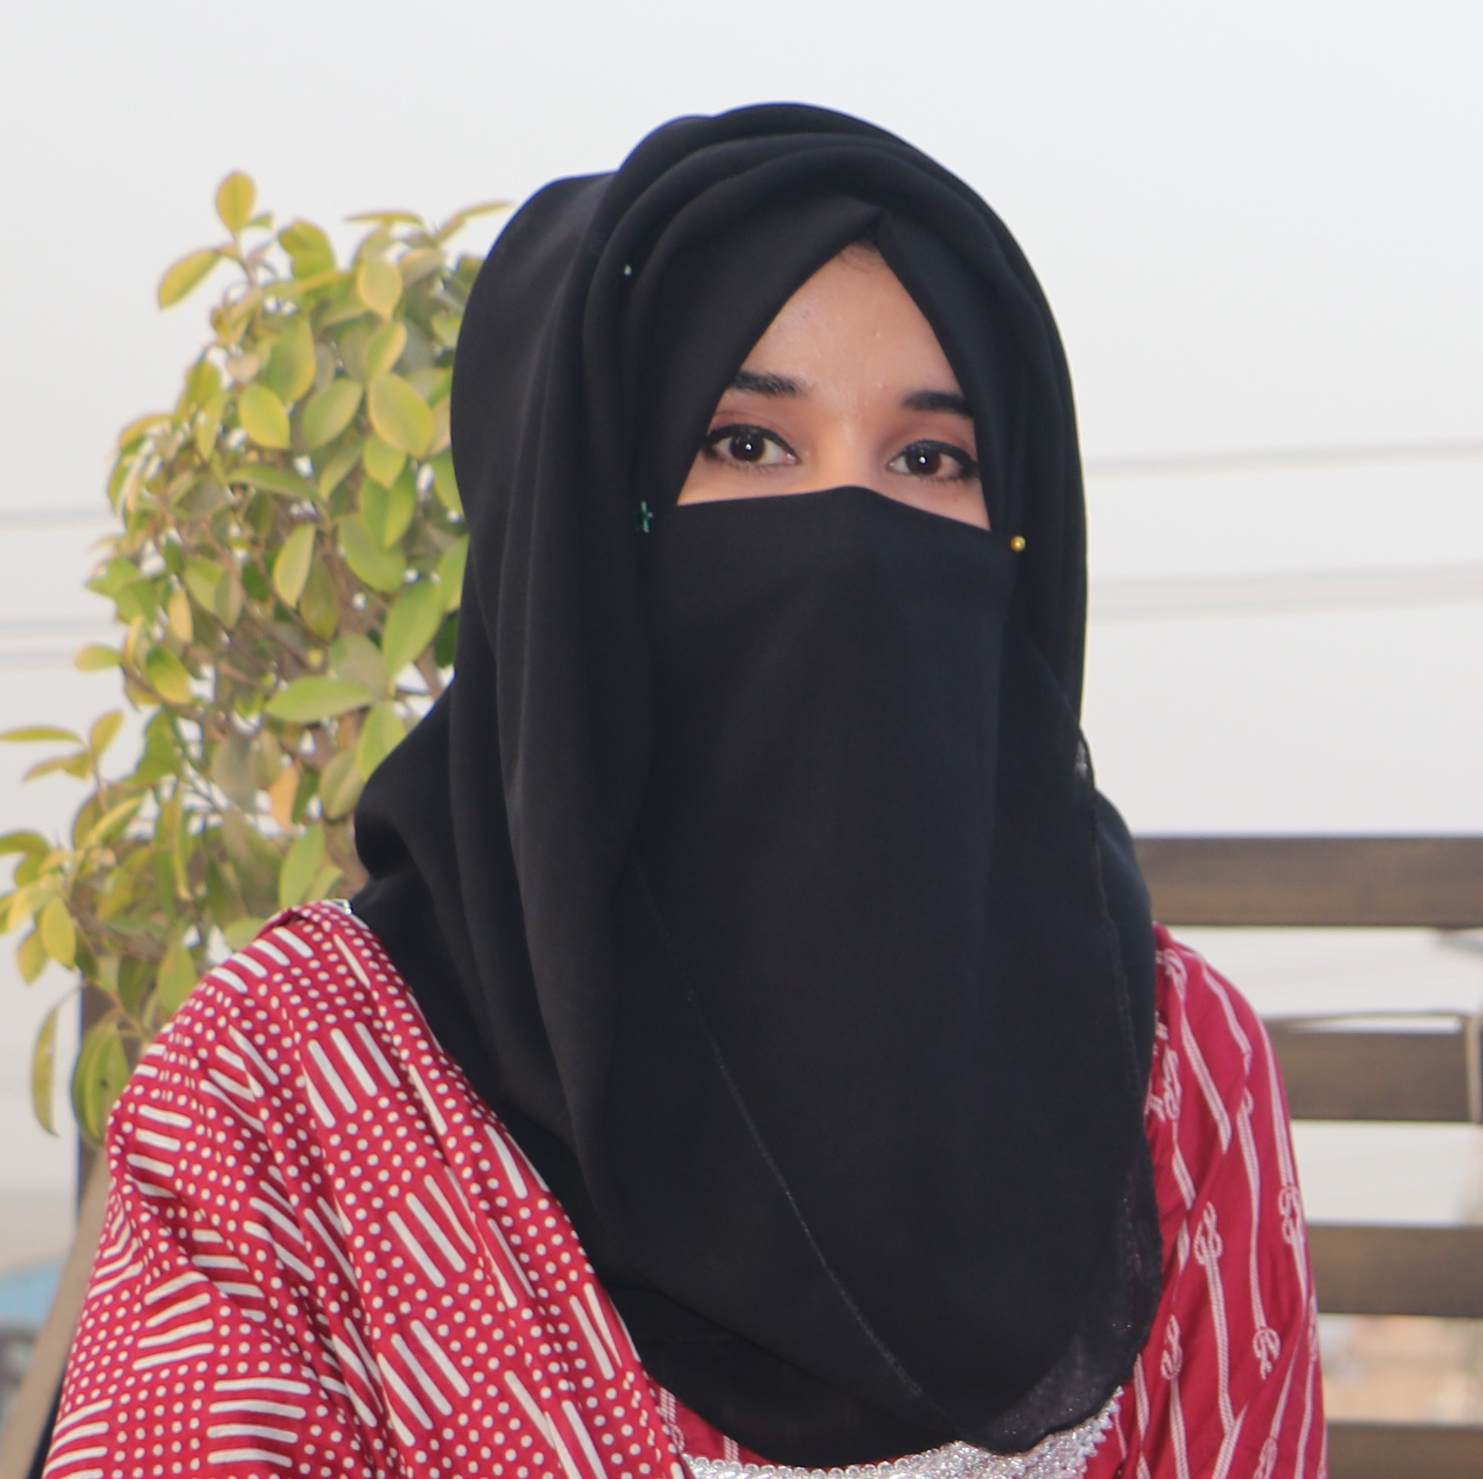
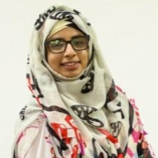
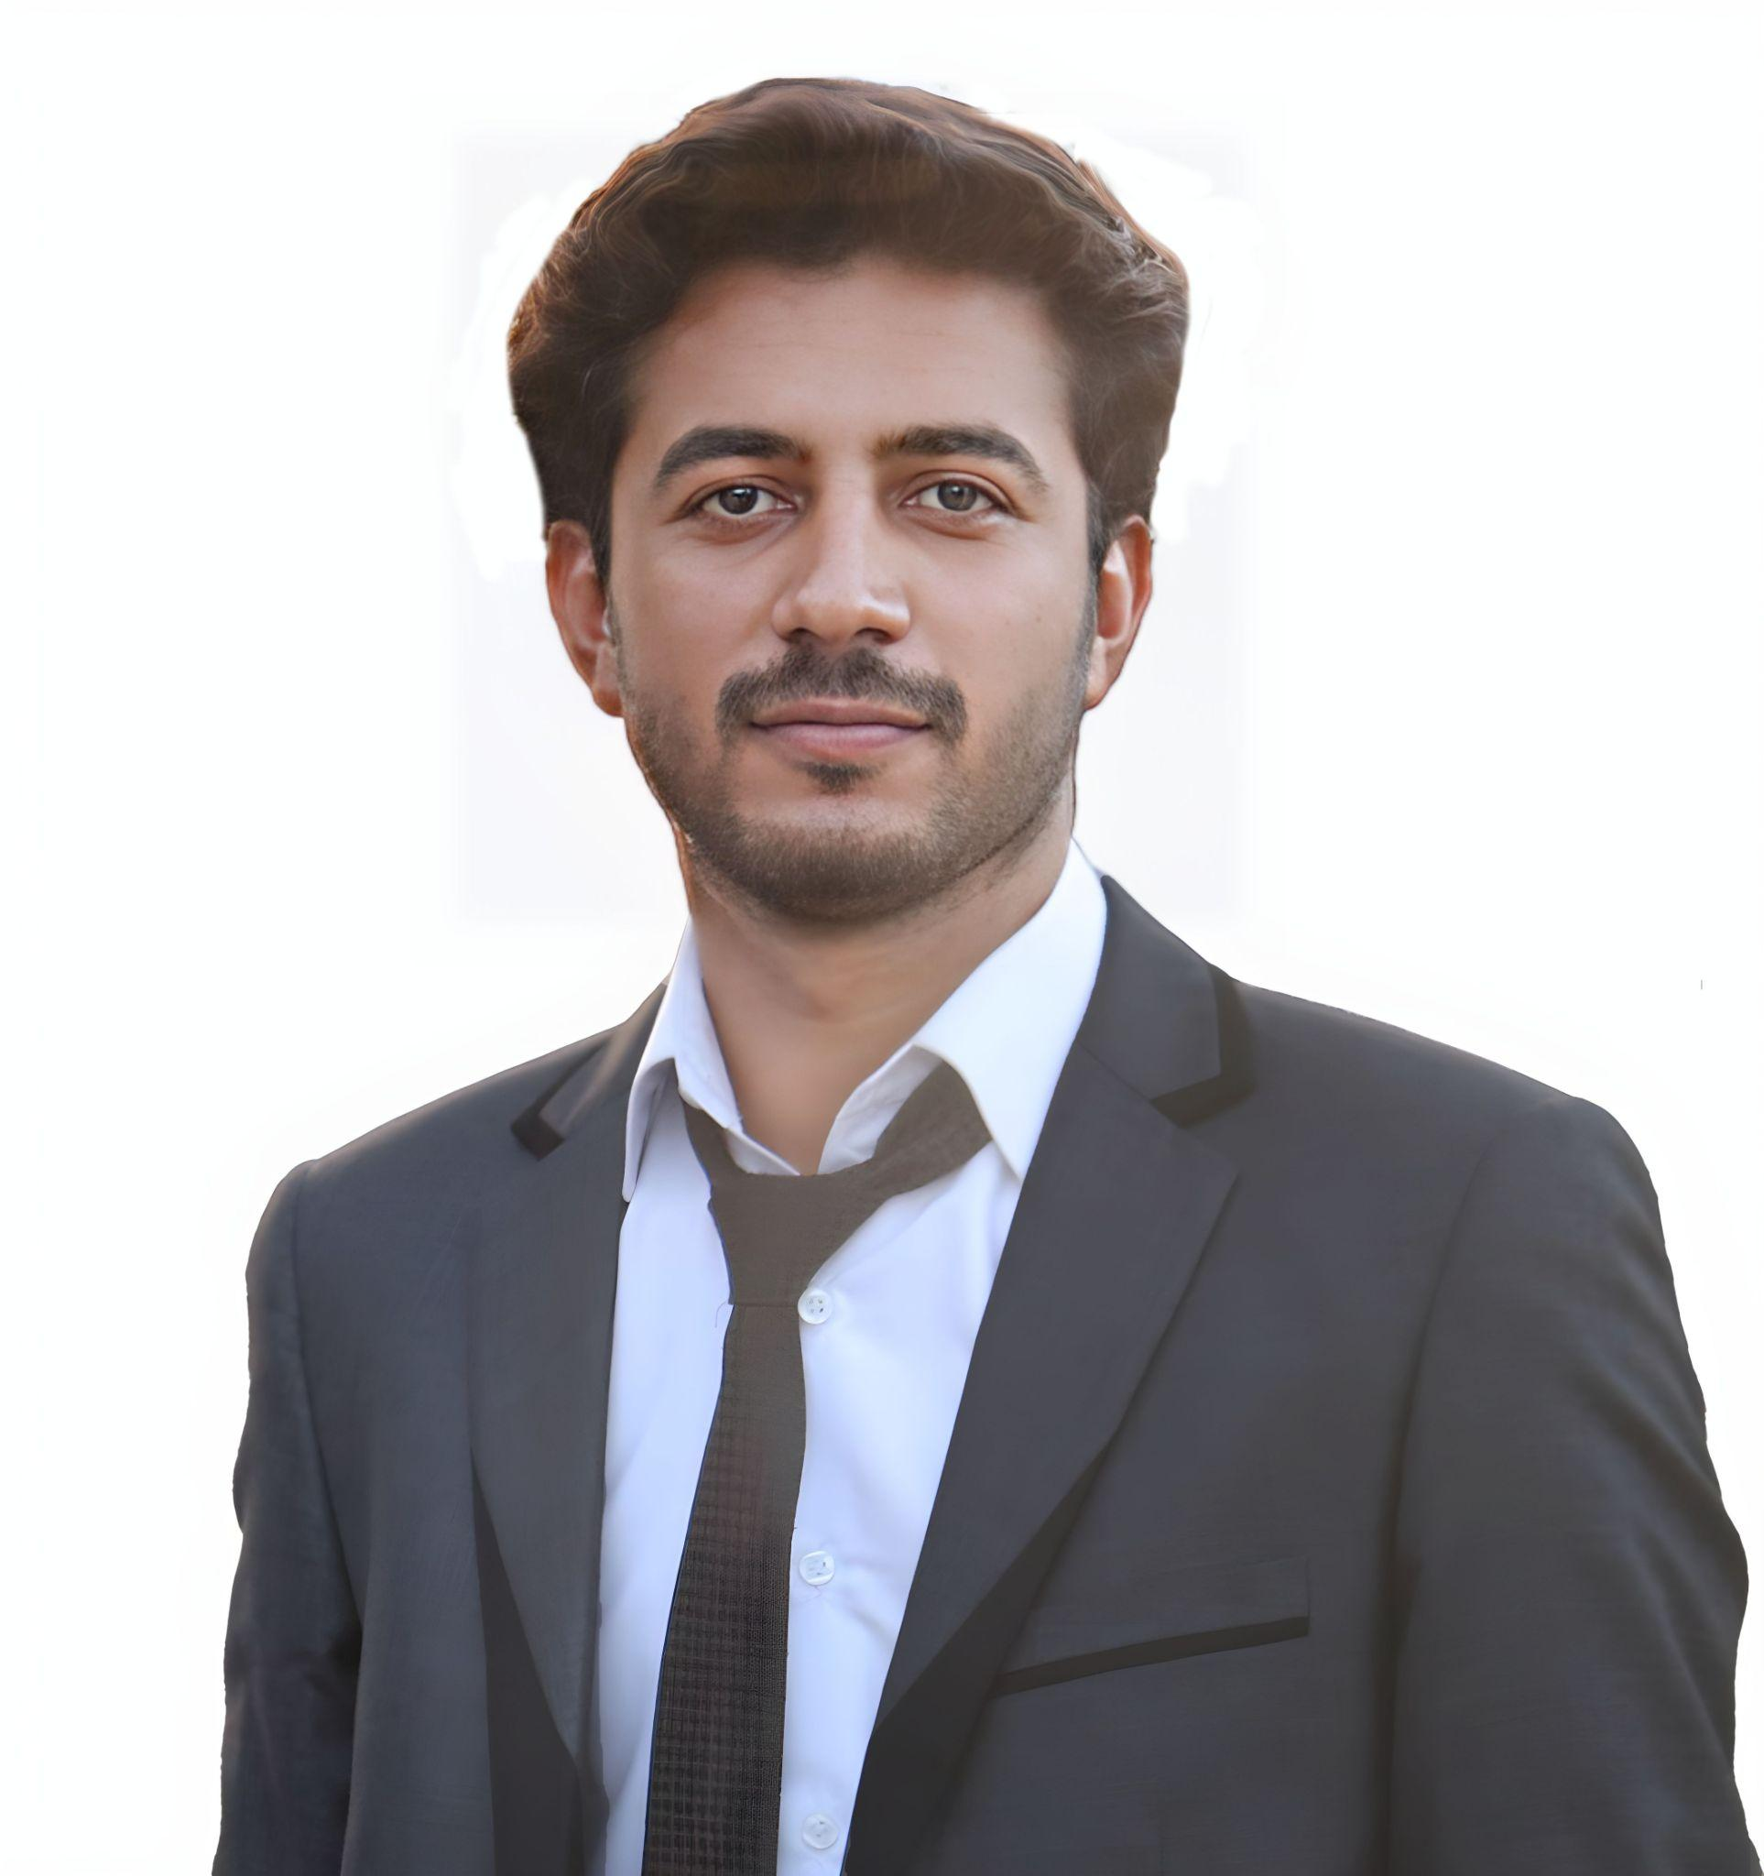
Our Team
Tasneem Ahmed
CTO
Kanwal Aftab
CEO
ShahRukh Aleem
CMO

Slide 15
Thanks!
https://tinyurl.com/4b8bcdam

